Slide 1

SDSU and UNLV
Data Report

Slide 2
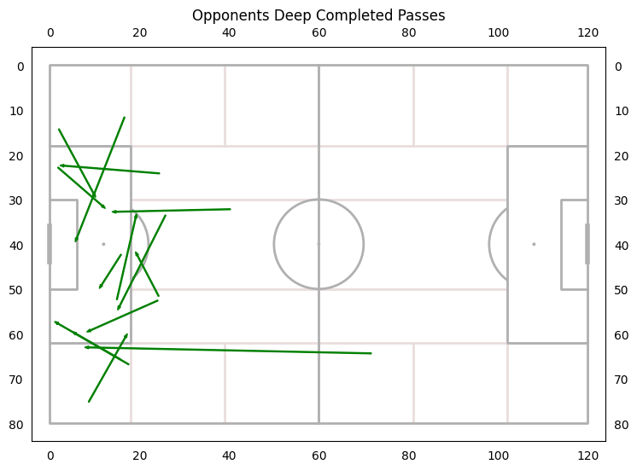
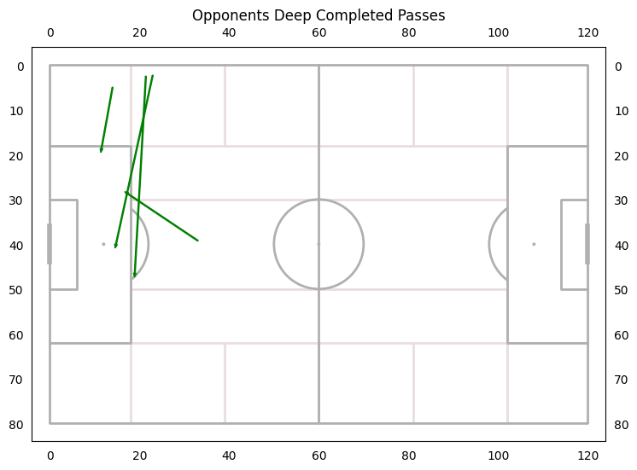
Opponents Deep Completed Passes
SDSU
UNLV

Slide 3
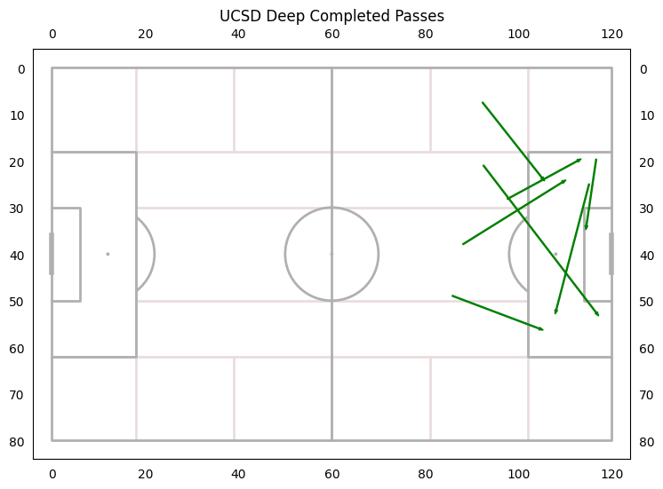
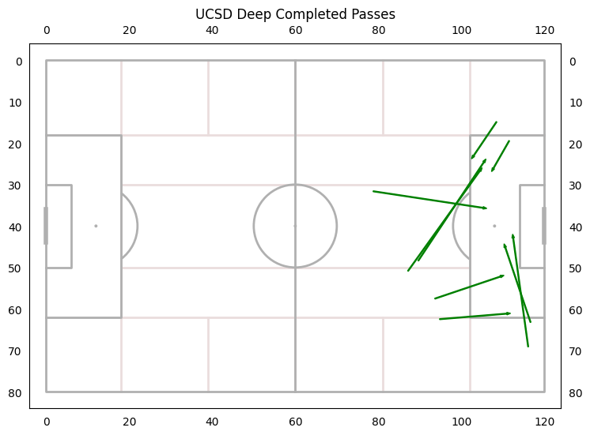
UCSD Deep Completed Passes
SDSU
UNLV

Slide 4
Throw Ins
SDSU had a throw in percentage of 86%
UCSD had a throw in percentage of 75% against SDSU
UNLV had a throw in percentage of 84%
UCSD had a throw in percentage of 78.5% against UNLV

Slide 5
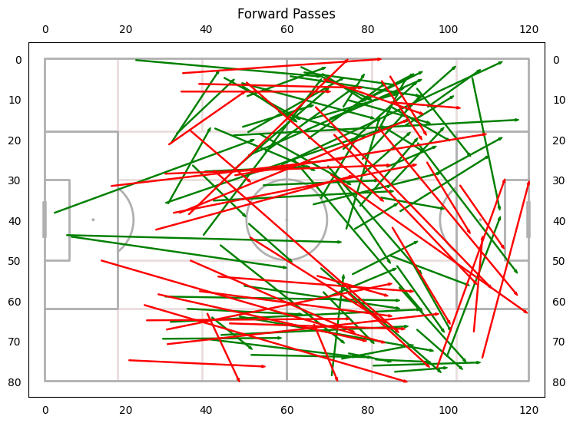
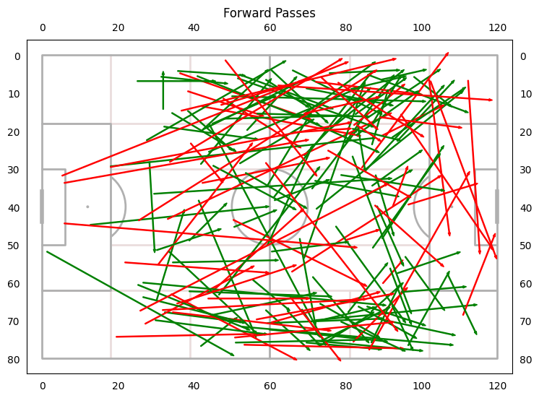
Forward Passes
SDSU
UNLV

Slide 6
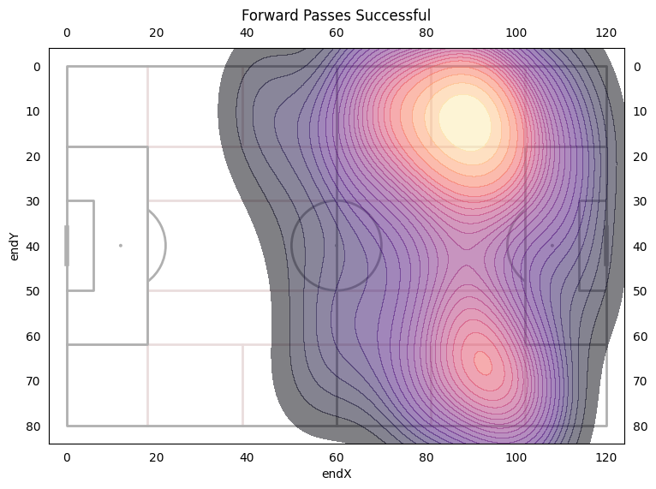
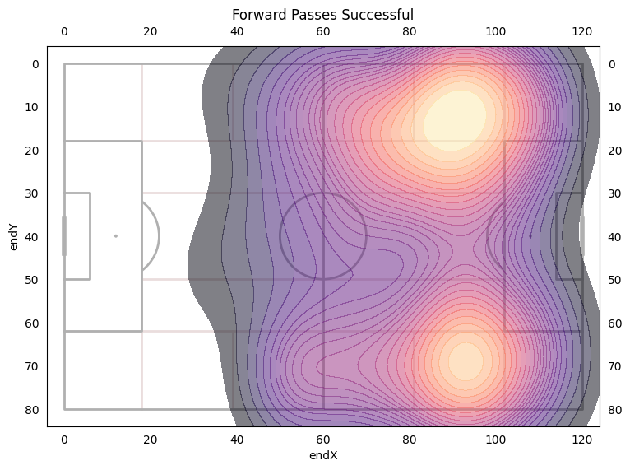
SDSU
UNLV

Slide 7
Comparison
Forward Pass Accuracy was the same at 66%
SDSU: 135 Forward Passes attempted - Same as last year’s average
UNLV: 177 Attempted Forward Passes - Increase of 42
Increase of 27 accurate forward passes from SDSU to UNLV

Slide 8
1st and 2nd Balls UNLV
Overall - 41% 1st Ball Win Rate | 61% 2nd Ball Win Rate
1st Half - 30% 1st Ball Win Rate | 53% 2nd Ball Win Rate
2nd Half - 48% 1st Ball Win Rate | 66.6% 2nd Ball Win Rate
If UNLV won the 1st ball UCSD won the second ball 63.2% of the time
If UCSD won the 1st ball UCSD won the second ball 55.2% of the time

Slide 9
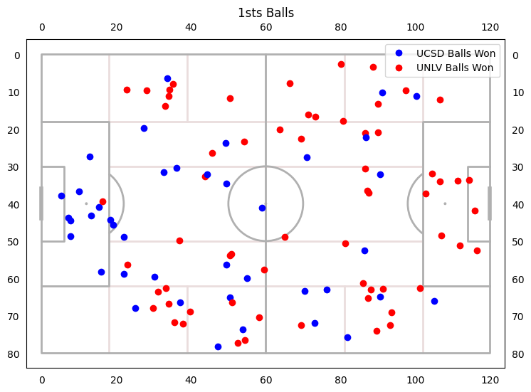
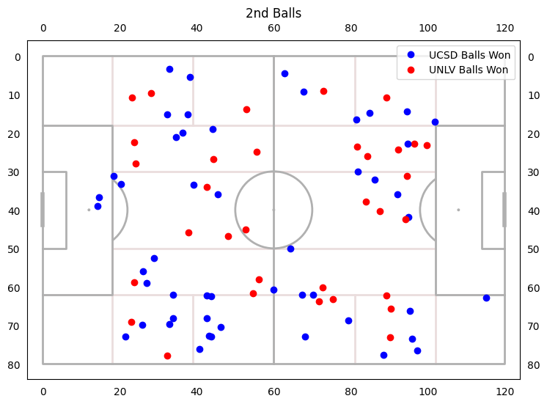

Slide 10
Goals
UCSD Deep Completed Passes >=8
Opponent Deep Completed Passes <=7
UCSD Throw in Percentage >=80%
Opponent Throw In Percentage <=80%
Forward Passes Accuracy of 72%
1st Ball Win Rate >= 40%
2nd Ball Win Rate >=58%
Given lost 1st Bal 2nd Ball Win Rate >=55%

